Slide 1

Java Programming Essentials: A Comprehensive Journey into Core Java and Beyond
- Bharath Ashok

Slide 2

Day 13

Slide 3
Day 13: Agenda
Collection Traversals
Fail-safe and Fail-Fast Iterators
Map Interface
HashMap
LinkedHashMap
TreeMap
ConcurrentHashMap
Hands-on
Assignments
Interview Questions

Slide 4
Collection Framework

Slide 5
Traversing Iterable Collections

Slide 6
Traversing Collections
Using For-Each Loop (Enhanced for Loop): This loop provides a concise way to iterate over collections that implement the Iterable interface, such as lists and sets. It simplifies the process of iterating and accessing elements.
Using Iterator: The Iterator interface provides a way to traverse any collection that implements it. It allows you to remove elements during traversal, which is not possible with the for-each loop.
Using ListIterator: This is a specialized iterator for lists that allows bidirectional traversal (forward and backward) and modification of elements.
Using Streams: Introduced in Java 8, streams provide a functional approach to traversing and processing collections. They allow you to apply various operations such as filtering, mappingon the collection elements.

Slide 7
Traversing Hands-On

Slide 8
Fail-Safe and Fail-Fast Iterators

Slide 9
Fail-Fast Iterators
Fail-fast iterators are designed to quickly detect any concurrent modifications and throw a ConcurrentModificationException to signal that the underlying collection has been modified while being iterated.
They provide immediate feedback about the inconsistency in the collection's state
Real-time scenario example for fail-safe iterators:
Imagine we are developing a banking application with multiple threads. One thread is iterating over a list of customer transactions while another thread is processing deposits and withdrawals concurrently.
In this case, if a fail-fast iterator is used, any concurrent modification (such as adding a new transaction) will lead to a ConcurrentModificationException, indicating that the collection's structure has changed unexpectedly.

Slide 10
Fail-Safe Iterators
Fail-safe iterators are designed to work safely in the presence of concurrent modifications to the underlying collection.
Instead of throwing a ConcurrentModificationException, fail-safe iterators create a copy of the collection at the beginning of iteration and iterate over the copy.
This means that they won't reflect changes made after the iterator was created
Real-time scenario example for fail-safe iterators:
Suppose we have a multi-threaded application where one thread is iterating over a collection, and another thread is modifying it concurrently.
In this scenario, using fail-safe iterators prevents the iterator from throwing exceptions, and the iteration will continue over the original collection without reflecting the concurrent modifications.

Slide 11
Fail-Safe and Fail-Fast Iterators Hands-on

Slide 12
Maps

Slide 13
Map Interface
Map interface is a part of the Java Collections Framework and provides a way to store and manage key-value pairs.
It represents a collection of objects where each object is associated with a unique key that can be used to retrieve the corresponding value.
Key Features:
Key-Value Pairs: A Map stores data as key-value pairs. Each key is associated with a single value. Keys are unique within the map.
Methods: The Map interface defines several methods for adding, retrieving, removing, and manipulating key-value pairs. Some of the common methods include put(key, value), get(key), remove(key), containsKey(key), containsValue(value), and size().
Iterating: You can iterate over the keys, values, or key-value pairs using methods like keySet(), values(), and entrySet().
Implementation Varieties: Java provides several implementation classes for the Map interface, each with its own characteristics and use cases.

Slide 14
Common Implementations Of Map
HashMap:
Stores key-value pairs in an unordered manner, using a hashing mechanism.
Offers constant-time average-case performance for insertion, deletion, and retrieval. Does not guarantee the order of elements.
LinkedHashMap:
Similar to HashMap, but maintains the order of elements based on their insertion sequence.
Uses a doubly-linked list to maintain insertion order. Slightly slower than HashMap due to the additional linked list operations.
TreeMap:
Stores key-value pairs in a sorted order based on the natural order of keys or a custom comparator.
Offers logarithmic time complexity for insertion, deletion, and retrieval operations.
Well-suited for cases where elements need to be accessed in sorted order.
Hashtable:
Similar to HashMap but is synchronized (thread-safe).
Slower than HashMap due to synchronization overhead.
ConcurrentHashMap:
Optimized for concurrent access from multiple threads.
Provides high concurrency and scalability without the need for external synchronization.
Divides the data into segments to allow concurrent access to different segments.

Slide 15
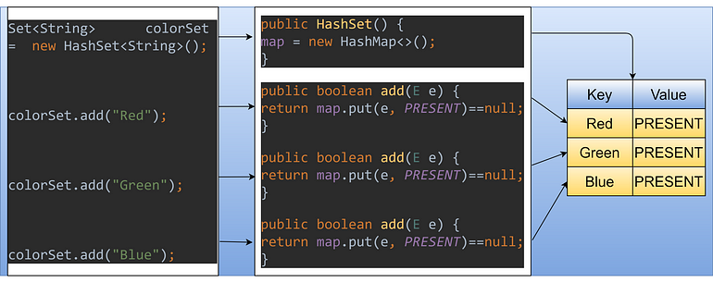
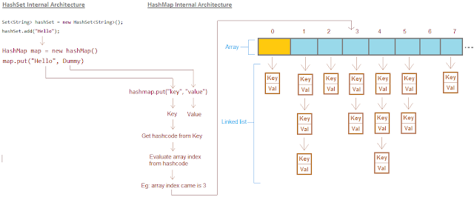
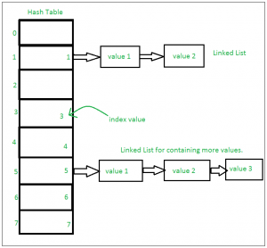
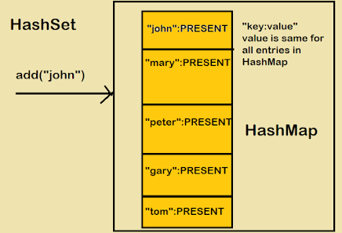
HashSet Internal Working

Slide 16
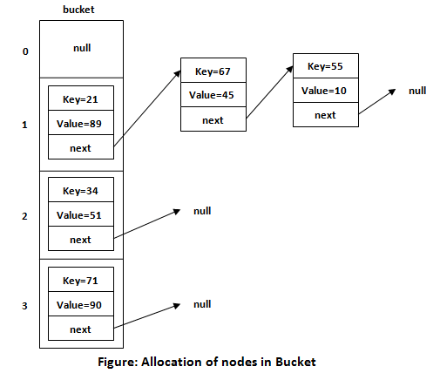
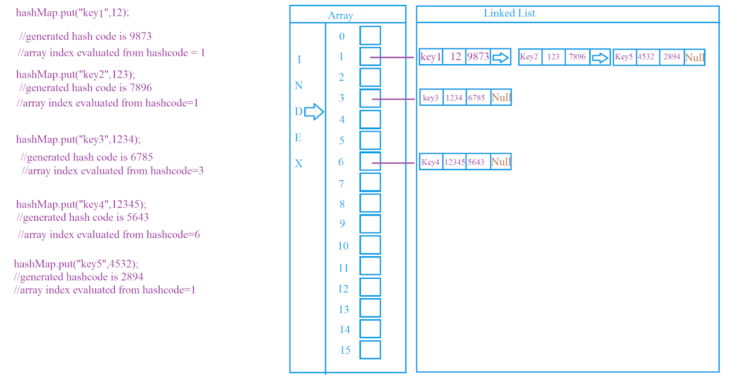
HashMap Internal Working

Slide 17
HashSet Internal Working
import java.util.HashSet;
public class HashSetExample {
public static void main(String[] args) {
Map<String, Integer> hashMap = new HashMap<>(4, 0.75f);
hashMap.put("Alice", 25);
hashMap.put("Bob", 30);
hashMap.put("Charlie", 28);
hashMap.put("David", 22);
hashMap.put("Eva", 32);
System.out.println(hashMap); }
}
Output:
HashSet: [Banana, Grapes, Orange, Pear, Apple]
Insertion:
"Apple": Hash code = 65 + 112 + 112 + 108 + 101 = 498. Hash code % 10 (bucket count) = 8. Placed in bucket 8.
"Banana": Hash code = 66 + 97 + 110 + 97 + 110 + 97 = 577. Hash code % 10 = 7. Placed in bucket 7.
"Orange": Hash code = 79 + 114 + 97 + 110 + 103 + 101 = 604. Hash code % 10 = 4. Placed in bucket 4.
"Grapes": Hash code = 71 + 114 + 97 + 112 + 101 + 115 = 610. Hash code % 10 = 0. Placed in bucket 0.
"Pear": Hash code = 80 + 101 + 97 + 114 = 492. Hash code % 10 = 2. Placed in bucket 2.
Collisions:
In the example above, "Apple" and "Pear" have the same bucket index (bucket 8).
This is a collision. HashSet handles collisions by creating a linked list (or a tree in newer versions) in that bucket.
Similarly, "Grapes" and "Banana" end up in the same bucket (bucket 7), causing another collision.
Retrieval:
When you retrieve an element, the same hash code calculation and modulo operation are performed to locate the bucket.
The linked list (or tree) in the bucket is searched to find the desired element.

Slide 18
Java.util.HashMap
HashMap is a data structure that implements the Map interface, allows to store key-value pairs.
It is a part of the Java Collections Framework and is commonly used to store and manage data in a way that enables efficient retrieval and storage based on keys.
Key Characteristics:
Key-Value Structure: A HashMap stores data in the form of key-value pairs. Each key is associated with a unique value. Keys are used to access the corresponding values.
Unordered Collection: A HashMap does not maintain the order of elements in which they were added. If you need to maintain the order, we can use a LinkedHashMap, which is a variant of HashMap that preserves the order of insertion.
Null Values and Keys: HashMap allows null values and a single null key. This means you can have a key with a null value associated with it.
Performance: HashMap provides constant-time (O(1)) average-case complexity for insertion, deletion, and retrieval operations. However, these operations might degrade to O(n) in certain situations, depending on factors like hash collisions.

Slide 19
Java.util.HashMap
Hashing Mechanism: HashMap uses a hashing mechanism to distribute keys across a range of buckets. The hash code of the key is used to determine the index of the bucket where the key-value pair will be stored. Java provides the hashCode() method that is used to calculate the hash code of objects. Properly implemented hashCode() methods help reduce collisions and improve HashMap performance.
Collision Handling: Hash collisions occur when two different keys produce the same hash code, resulting in the same bucket. HashMap uses a linked list to store multiple key-value pairs that have the same hash code in the same bucket.
Load Factor and Rehashing: The load factor determines the threshold at which the HashMap will resize itself to accommodate more elements. When the number of stored elements exceeds the product of the load factor and the current capacity, the HashMap is rehashed (buckets are redistributed) to maintain a low collision rate and ensure efficient performance.
Iteration: You can iterate through the key-value pairs in a HashMap using various methods, such as keySet(), values(), or entrySet(). The entrySet() method provides a way to iterate through both keys and values efficiently.

Slide 20
HashMap Hands-On

Slide 21
LinkedHashMap

Slide 22
Java.util.LinkedHashMap
LinkedHashMap is a subclass of HashMap that maintains the order of elements based on their insertion sequence.
In addition to the functionality inherited from HashMap, it uses a doubly-linked list to preserve the insertion order of keys.
This makes it useful when you need to maintain both fast retrieval of data and a predictable iteration order.
Internal Implementation:
The internal implementation of LinkedHashMap involves a combination of a hash table and a doubly-linked list:
Hash Table: The hash table stores the key-value pairs, providing quick access to elements through their hash codes.
Doubly-Linked List: A doubly-linked list maintains the order of insertion. Each entry in the list corresponds to a key-value pair, and the entries are linked together in the order they were added.

Slide 23
LinkedHashMap Hands-On

Slide 24
TreeMap

Slide 25
Java.util.TreeLinkedHashMap
TreeMap is another implementation of the Map interface in Java, which provides a sorted order for its elements based on the natural order of keys or a custom comparator.
TreeMap maintains its elements in a sorted order based on the keys.
Unlike HashMap or LinkedHashMap, the order of elements in a TreeMap is determined by the keys themselves, not the insertion order.

Slide 26
TreeMap Hands-On

Slide 27
ConcurrentHashMap

Slide 28
Java.util.ConcurrentHashMap
ConcurrentHashMap is a class in Java's java.util.concurrent package.
It's a thread-safe implementation of the Map interface.
Designed for high concurrency scenarios.
Allows multiple threads to read and write concurrently without explicit synchronization.
Achieves this by dividing the data into segments, each with its own lock.
Supports efficient read operations across segments.
Write operations are synchronized within individual segments.
Commonly used in scenarios like caching, parallel processing, and concurrent data management.

Slide 29
Features of ConcurrentHashMap
Thread-Safe Map: ConcurrentHashMap is a class in Java's java.util.concurrent package that provides a thread-safe implementation of the Map interface.
Concurrency Support: It's designed for scenarios where multiple threads can access the map concurrently without external synchronization.
Highly Scalable: ConcurrentHashMap is optimized for high concurrency situations, making it efficient for applications with frequent concurrent read and write operations.
Segmented Structure: Internally, the map is divided into segments or partitions, each of which is independently locked. This structure reduces contention when multiple threads access different segments.
Fine-Grained Locking: Each segment has its own lock, allowing multiple threads to modify different segments simultaneously without blocking each other.
Efficient Reads: Read operations can occur concurrently across different segments, improving read throughput.
Synchronized Writes: Write operations are synchronized on a per-segment basis, allowing multiple threads to write concurrently as long as they target different segments.

Slide 30
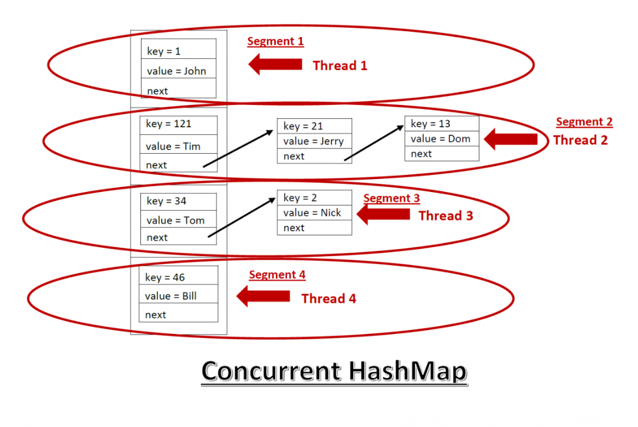
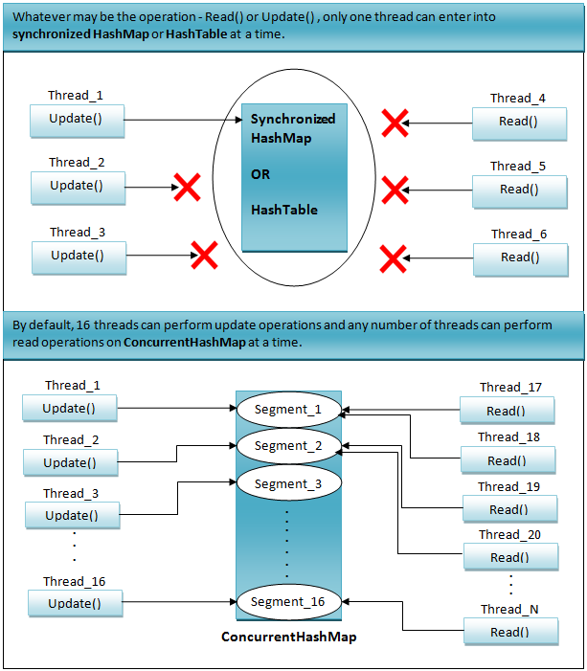
Internal Implementation Of ConcurrentHashMap

Slide 31
ConcurrentHashMap Hands-On

Slide 32
Interview Questions

Slide 33
HashMap Interview Questions
What is a HashMap in Java?
Explain the internal structure of a HashMap.
How does HashMap handle key collisions?
What is the difference between HashMap and HashTable?
What is the time complexity of operations like insertion, deletion, and retrieval in a HashMap?
Explain the role of hash code in a HashMap.
Can you have duplicate keys in a HashMap?
Why is it important that keys in a HashMap are immutable?
How can you iterate over the entries of a HashMap?
What is the default initial capacity and load factor of a HashMap?
When would you use a HashMap over other data structures?

Slide 34
LinkedHashMap Interview Questions
What is a LinkedHashMap and how is it different from a regular HashMap?
Explain the concept of insertion order in a LinkedHashMap.
When might you choose to use a LinkedHashMap over a HashMap?
What is the additional memory overhead of using a LinkedHashMap compared to a HashMap?

Slide 35
TreeMap Interview Questions
What is a TreeMap?
How does TreeMap differ from HashMap in terms of key ordering?
What is the time complexity of basic operations in a TreeMap?
Explain how TreeMap maintains its elements in a sorted order.
What are the requirements for keys placed in a TreeMap?
When would you use a TreeMap over a HashMap?
Can you store null keys or values in a TreeMap?

Slide 36
ConcurrentHashMap Interview Questions
What is the purpose of ConcurrentHashMap in Java?
How does ConcurrentHashMap achieve thread-safety while allowing high concurrency?
Explain the concept of "segmentation" in ConcurrentHashMap and how it contributes to its performance.
What are the main differences between ConcurrentHashMap and synchronized collections like Hashtable or Collections.synchronizedMap?
Can you explain how ConcurrentHashMap handles resizing to accommodate more elements?
What happens if two threads attempt to modify different segments of a ConcurrentHashMap simultaneously?
How does ConcurrentHashMap handle corner cases like null keys or values?

Slide 37
Assignments

Slide 38
Map Assignments
Assignment 1: Shopping Cart with HashMap
Implement a simple shopping cart system. Create a program that allows users to add products to their cart, specify quantities, and calculate the total cost. Use a HashMap to store products and their prices. Provide options to list the items in the cart and display the final bill.
Assignment 2: Student Grades using TreeMap
Design a student grade tracking system. Allow teachers to input student names and their respective grades. Use a TreeMap to store students' names as keys and their grades as values. Implement functions to add students, update grades, and display the student names along with their grades in alphabetical order.
Assignment 3: Contact Manager with LinkedHashMap
Develop a contact management application. Use a LinkedHashMap to store contacts with names and phone numbers. Allow users to add new contacts, search for contacts by name, and list all contacts in the order they were added.

Slide 39
Map Assignments
Assignment 4: Frequency Counter with HashMap
Write a program that takes a sentence as input and uses a HashMap to count the frequency of each word. Display the words and their corresponding frequencies in alphabetical order.
Assignment 5: Library Catalog using TreeMap
Create a simple library catalog system. Use a TreeMap to store book titles as keys and their authors as values. Allow users to add new books, search for books by title, and list all books in alphabetical order of titles.
Assignment 6: Song Playlist with LinkedHashMap
Design a music playlist program. Use a LinkedHashMap to store songs and their artists. Allow users to add songs to the playlist, remove songs, and play them in the order they were added.

Slide 40
ConcurrentHashMap Assignments
Assignment 1: Concurrent User Profiles
You are creating a basic user profile system for a website. Each user has a unique ID, name, and email. Design a program using ConcurrentHashMap to store user profiles. Implement methods to add new user profiles, retrieve user information by ID, and display a list of all users.
Assignment 2: Concurrent Quiz Score Tracker
You are building a quiz platform where students take quizzes online. Create a simple program using ConcurrentHashMap to track quiz scores. Each student is identified by a unique ID, and their quiz scores are stored. Implement methods to add quiz scores, retrieve scores by student ID, and calculate the average score

Slide 41
Q&A

